Slide 1
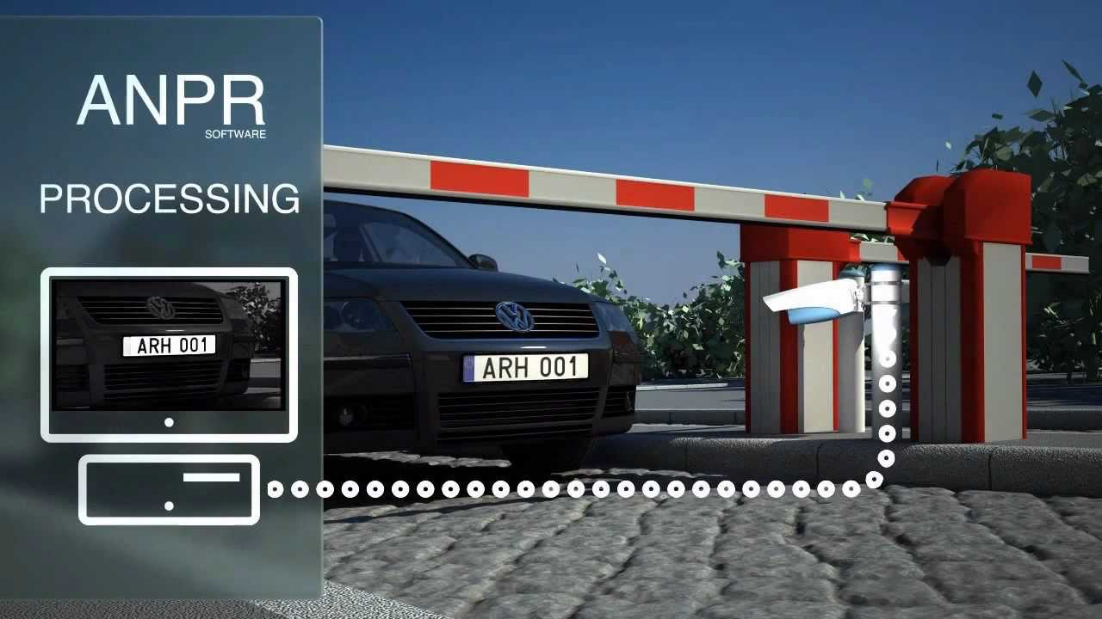
Automatic Number Plate Recognition
Anirudh Behera B2020009
Divyanshu Jangid B202020

Slide 2
Introduction
Automatic number plate recognition (ANPR) is an image processing technology which uses number (license) plate to identify the vehicle.
The objective is to design an efficient automatic authorized vehicle identification system by using the vehicle number plate.
The system is implemented on the entrance for security control of a highly restricted area like military zones or area around top government offices e.g. Parliament, Supreme Court etc.

Slide 3
Methodology
Install and import dependencies
Read in image, Grayscale and Blur
Find contours and apply mask
Read text using easy OCR
Render result

Slide 4
1. Packages and dependencies used
OpenCV
easyOCR
PyTorch
Matplotlib
Numpy
Imutils

Slide 5
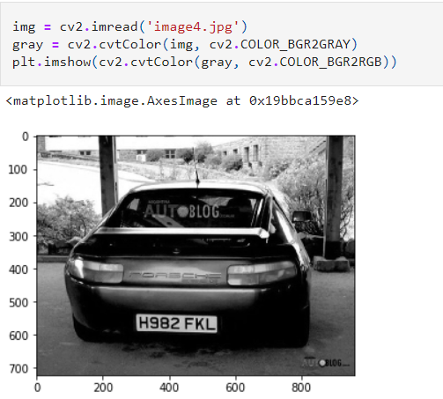
2. Reading the image, grayscale and blur
Read the image using opencv
Recolour the image
Display the image using matplotlib

Slide 6
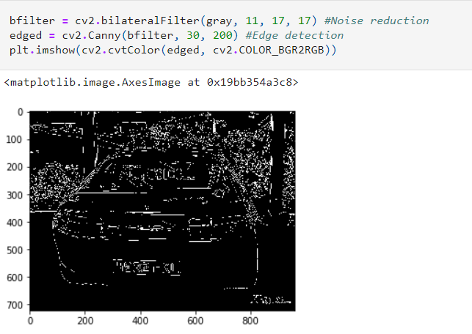
3. Applying color shifts and changes to images
Noise reduction in the image can be done using the bilateral filter method
Canny algorithm was used for edge detection

Slide 7
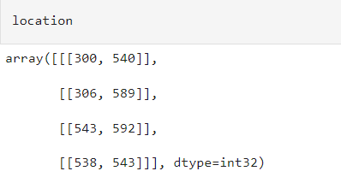
4.Detecting contours
Detect contour which has 4 points (i.e. rectangle)
This is done using OpenCV find Contours

Slide 8
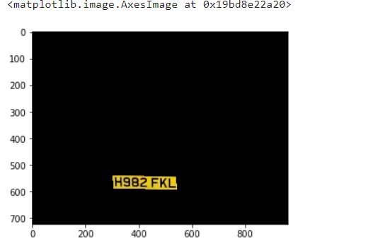
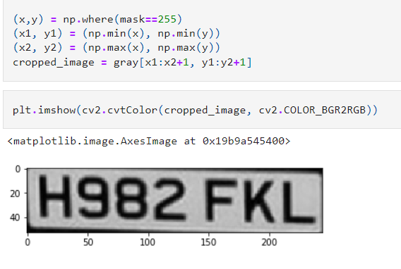
5.Masking number plates to improve text extraction for OCR
Create a blank mask with the same shape as the gray image
Draw contours within the image
Overlay the mask over the original image
Isolate the required section using easyOCR

Slide 9
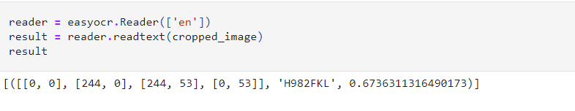
6. Extracting number plate text using EasyOCR

Slide 10
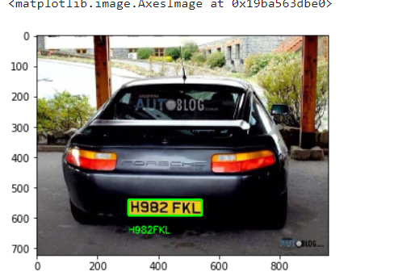
Displaying the final result
Convert it from BGR back to RGB and specify the coordinates to display the results

Slide 11
Drawbacks
May not work well in extreme weather conditions due to lack of visibility leading to lesser accuracy in the results
The most common challenge is the non-uniformity of license plate number models for different cities and countries. Their length may also vary. That's why the software must be customized to the place it’s being used in.
The fact that images and records are kept and stored raises some privacy concerns. This can be misused later

Slide 12
Conclusion
Despite all privacy concerns, license plate recognition software isn’t doing any of that. The only purpose of the information it collects is to help people feel more secure while they’re on the road and punish violence.
More cities are developing traffic control systems to help monitor the movement and flow of vehicles around the road network.

